Slide 1
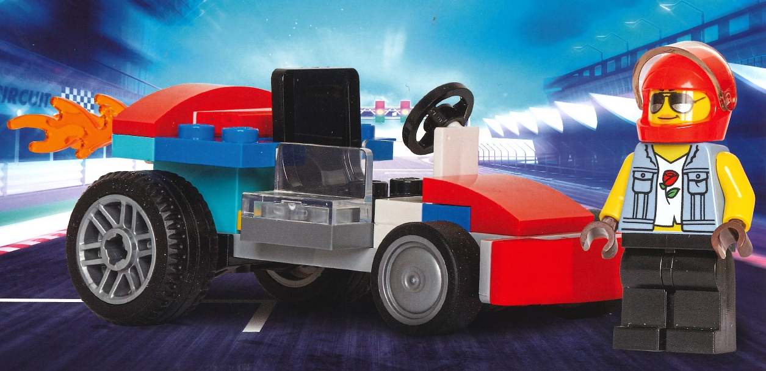

Designing the Lego Car and Optimizing the Distance
Team Members
Manichandra Domala
Vedanth Reddy Doddannagari
Shashank Madipelly

Slide 2
Objective
Our Objective is to design a model which suggests the Lego parts to design a car which can travel maximum distance .
And the model should consider all the constraints
such as cost, available parts.

Slide 3
Identifying factors that can significantly contribute to the distance a Lego car can travel.
Approach
Aerodynamic
Weight
Wheel Size
Surface Area

Slide 4
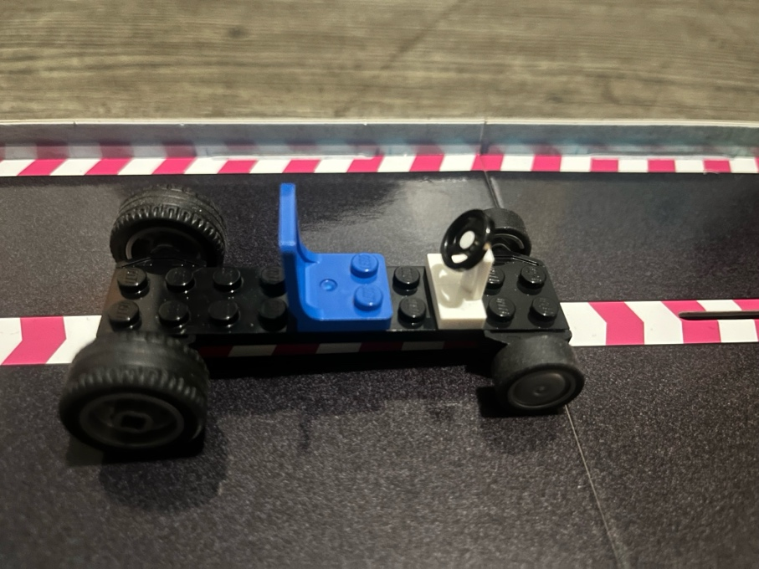
Identifying the basic parts to be included in your Lego Car
Basic element car should have :
Seat
Steering wheel
Motor
Wheels
Bearing elements
Plate
Fig: Body

Slide 5
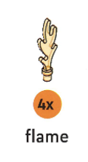
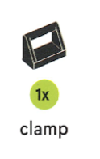
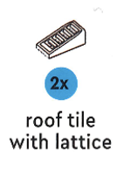
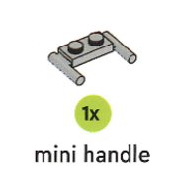
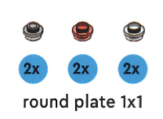
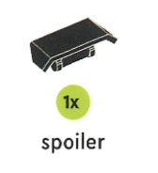
Test and Trail Approach
Considering (Small wheel + Slick tire + Bearing element) as one part and (Big wheel + Treaded tire + Bearing element) as another part and assigned the value for those. Because these things cannot be used separately.
Some parts can be excluded since they are not affecting car travelling distance. There value can be zero. Example :Spoiler , Flame , Clamp , Roof tile with lattice , mini handle , round plate 1x1 .

Slide 6
Add each part at a time to body of basic car(i.e.fig) and after experimenting multiple times then assigned a value to every part .
These values are assigned on basis of their contribution on making car move long distance.

Slide 7
 | Part Names | Cost (C_{i}) | Value (V_{i}) | Quantity (Q_{i})
X_1 | plate with bow | 2 | 3 | 8
X_2 | curved slope,2x3 | 2 | 4 | 1
X_3 | curved slope,1x3 | 2 | 7 | 2
X_4 | curved slope,2x2 | 2 | 3 | 5
X_5 | root tile | 3 | 3 | 1
X_6 | slope 2x3 | 3 | 2 | 1
X_7 | steering wheel | 3 | 0 | 2
X_8 | 2 Small wheel + 2 Slick tire + 1 Bearing element | 11 | 10 | 2
X_9 | 2 Big wheels + 2 Treaded tire + 1 Bearing element | 15 | 9 | 2
… | …. | … | … | ….

Slide 8
Decision Variables
Let X_{i} be the number of parts required of i^{th} part of Lego car.
Parameters
Parts(P_{i}): List of Part_names
Cost (C_{i}) : Cost of each i^{th} part
Value (V_{i}): Value of each i^{th} part
Quantity (Q_{i}): Quantity of each i^{th} part

Slide 9
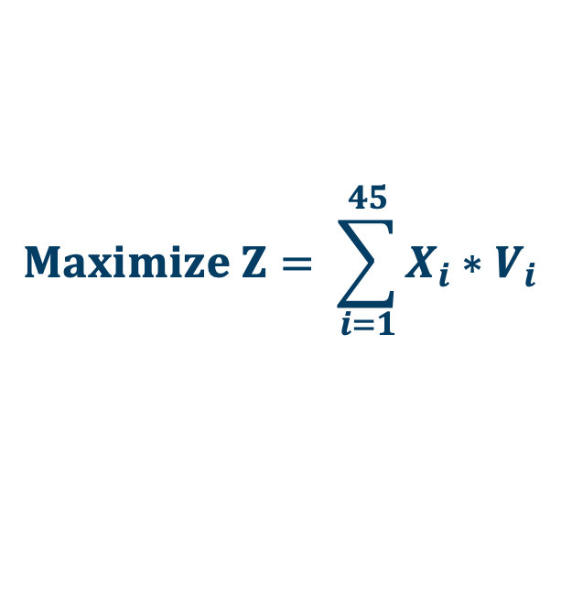
Mathematical model Objective Function
The objective is to maximize total contribution of the parts which helps to maximize the total distance travelled by the car within a $45 budget. It is determined by the value of each part multiplied by its quantity .
$$Maximize Z= \sum_{i=1}^{45}{X_{i}∗V_{i} }$$
Where:
X_{i} : # of parts required of i^{th} part of Lego car.
V_{i} : Value of each i^{th} part
Notes:
American Airlines Optimal crew scheduling saves $20 million/year Optimal yield management contributes $500 million per year
Revenue management saves National Car rental $56 million in one year
Better truck dispatching at Reynolds Metals improves on-time delivery and reduces annual freight costs by $7 million
Improved shipment routing saves Yellow freight over $17.3 million/year
GTE local access capacity expansion saves $30 million per year
Optimizing its global supply chains saves Digital Equipment over $300 million
Restructuring North America operations, Proctor and Gamble reduces plants by 20%, saving $200 million/year
Taha Steel (India) maximizes production in response to power shortages contributing $73 million
Improved production planning at Sadia (Brazil) saves $50 million over three years
Production optimization at Harris Corporation improves on-time deliveries from 75% to 90%
Optimal traffic control of the Hanshin Expressway in Osaka saves 17 million driver hours with benefits of $320 million
Better scheduling of hydro and thermal generating units saves Southern Company $140 million

Slide 10
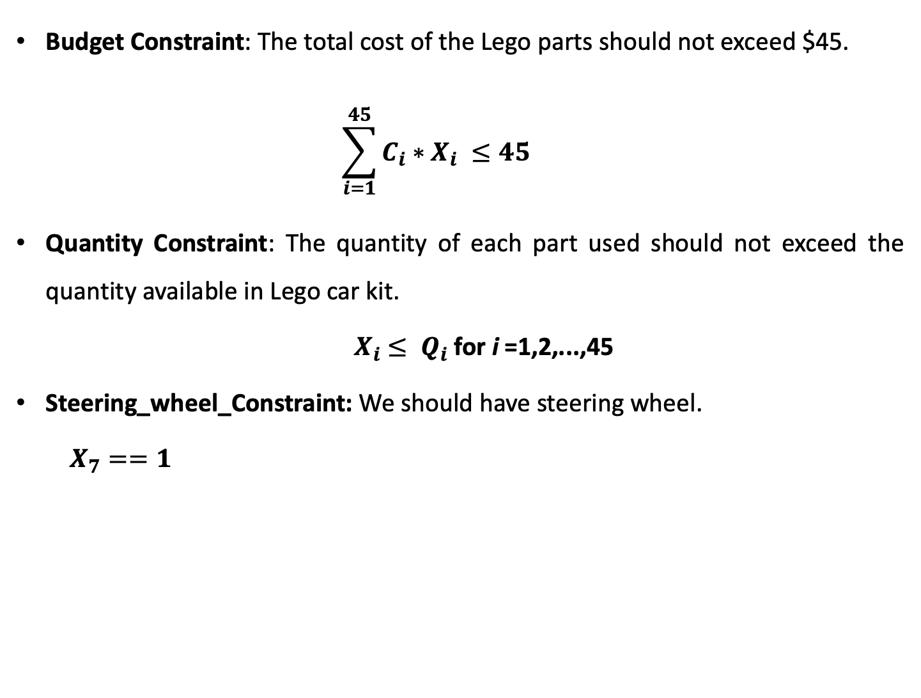
Constraints
Budget Constraint: The total cost of the Lego parts should not exceed $45.
$$\sum_{i=1}^{45}{C_{i}∗X_{i} ≤45}$$
Quantity Constraint: The quantity of each part used should not exceed the quantity available in Lego car kit.
$X_{i}$ $≤ Q_{i}$ for i =1,2,...,45
Steering_wheel_Constraint: We should have steering wheel.
$X_{7}==1$

Slide 11
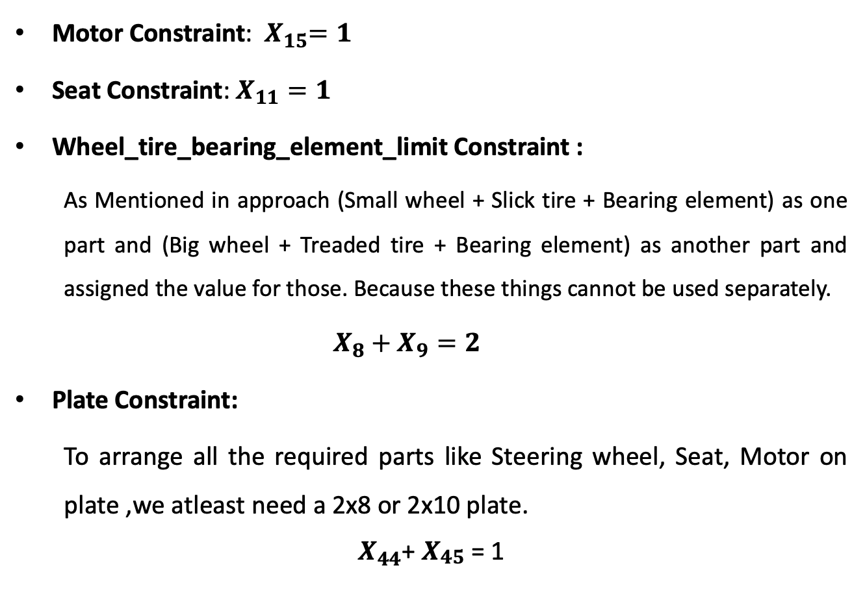
Motor Constraint: ${ X}_{15}=1$
Seat Constraint: $X_{11}=1$
Wheel_tire_bearing_element_limit Constraint :
As Mentioned in approach (Small wheel + Slick tire + Bearing element) as one part and (Big wheel + Treaded tire + Bearing element) as another part and assigned the value for those. Because these things cannot be used separately.
$$X_{8}+X_{9}=2$$
Plate Constraint:
To arrange all the required parts like Steering wheel, Seat, Motor on plate ,we atleast need a 2x8 or 2x10 plate.
$X_{44}$+ $X_{\begin{aligned}45 \\ \end{aligned}}$ = 1

Slide 12
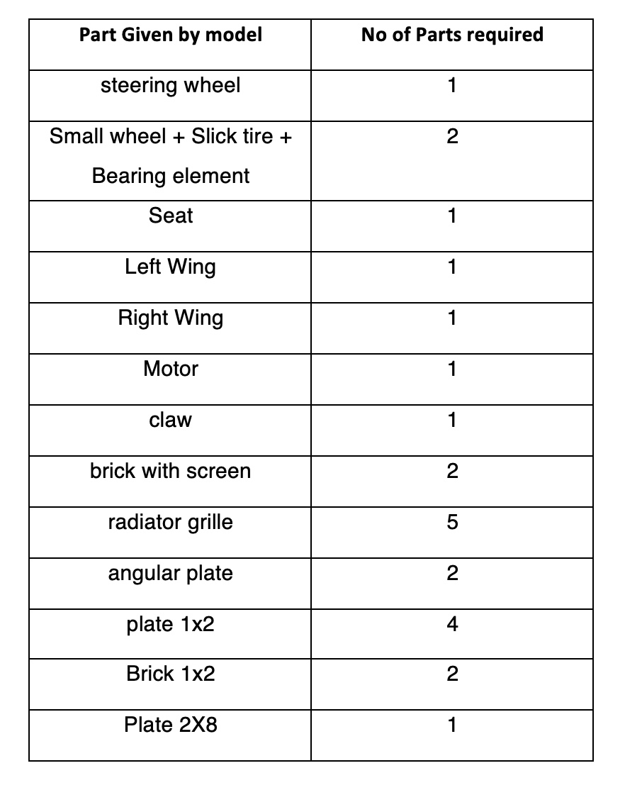
Output for model based on mathematical formulation using Cplex code
Cost = 45
total contribution = 78

Slide 13
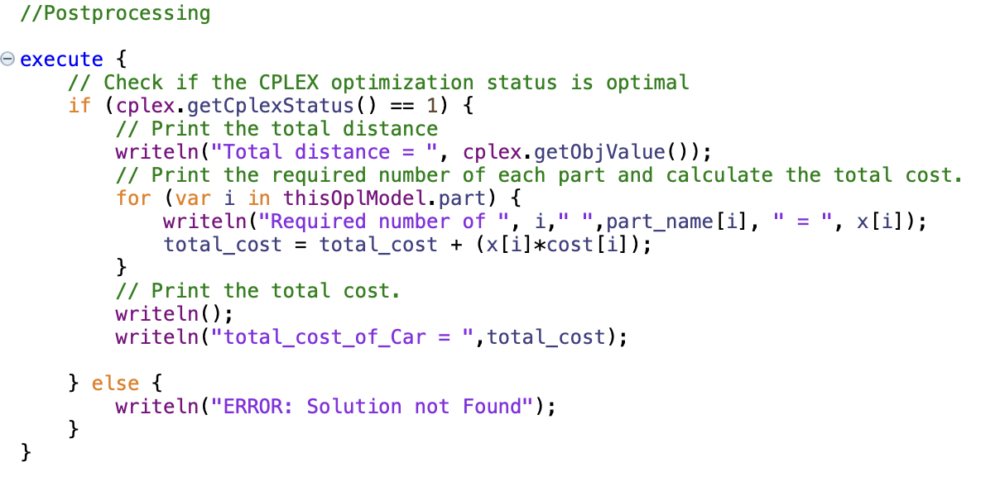

Slide 14
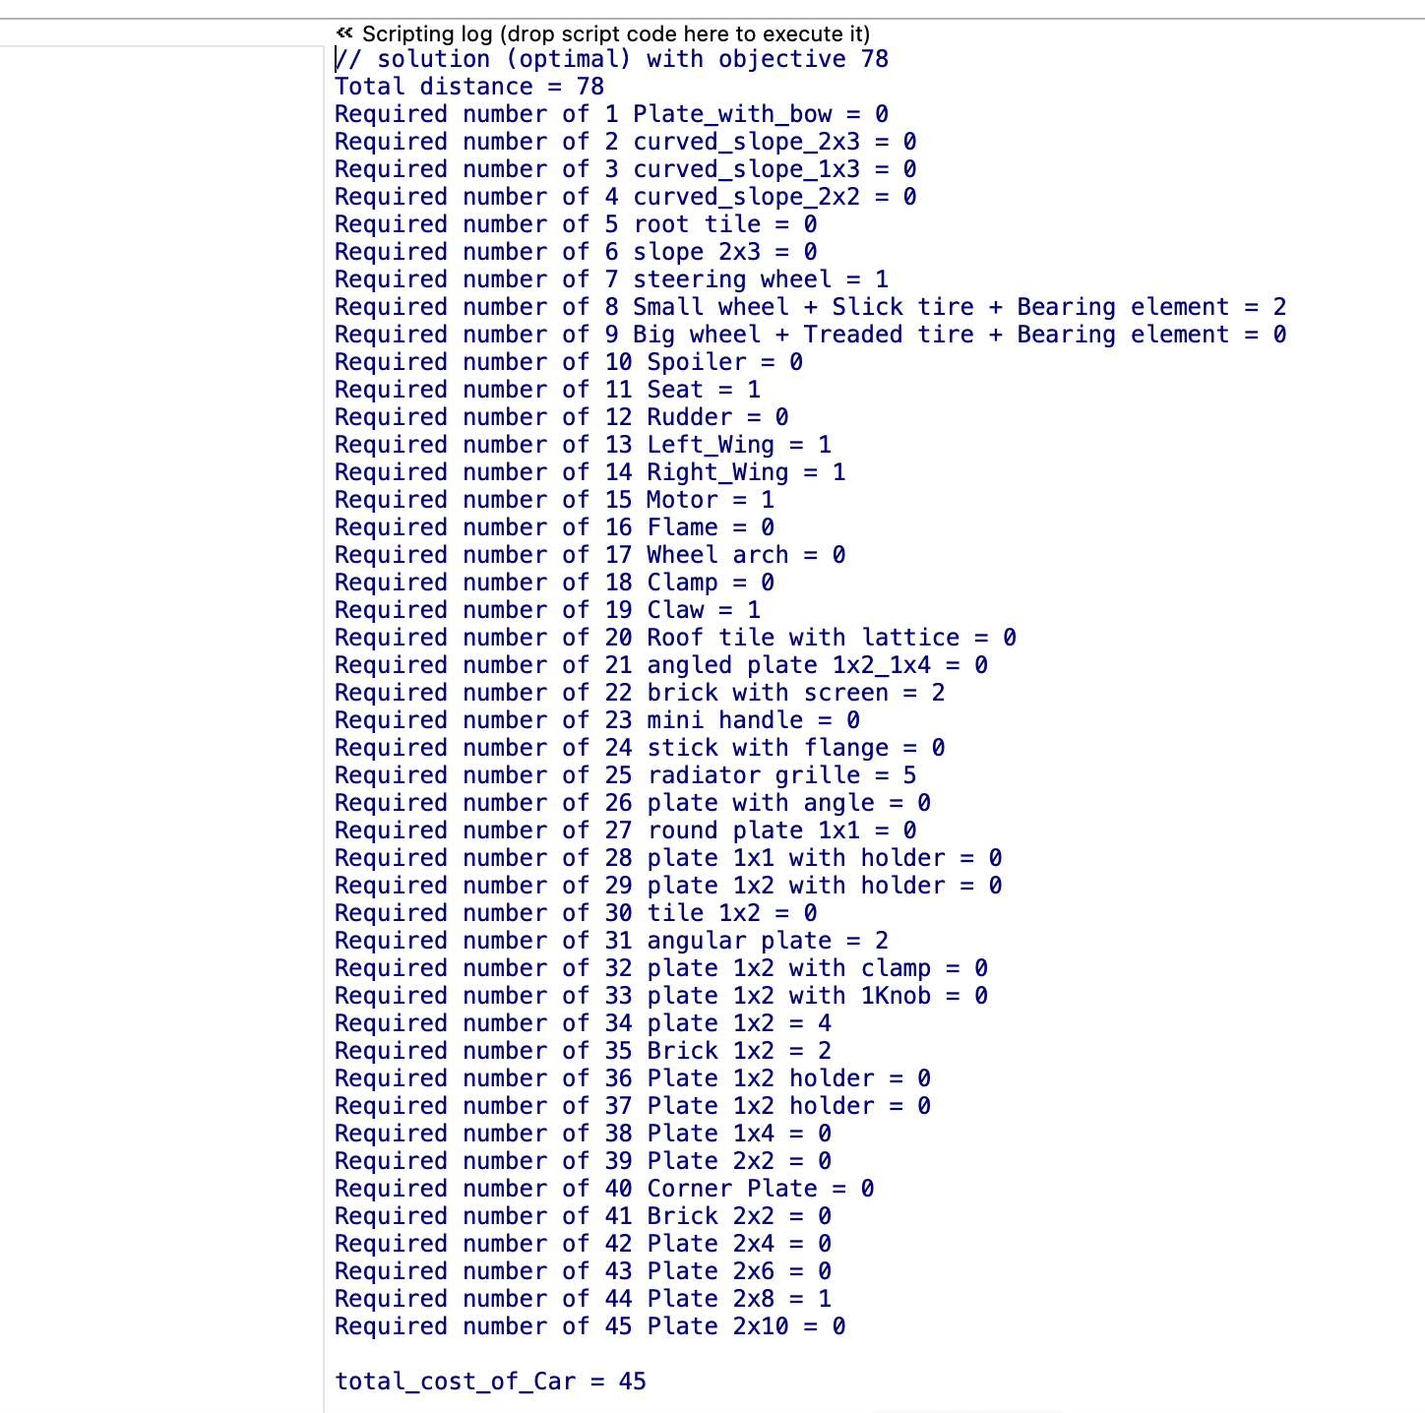

Slide 15
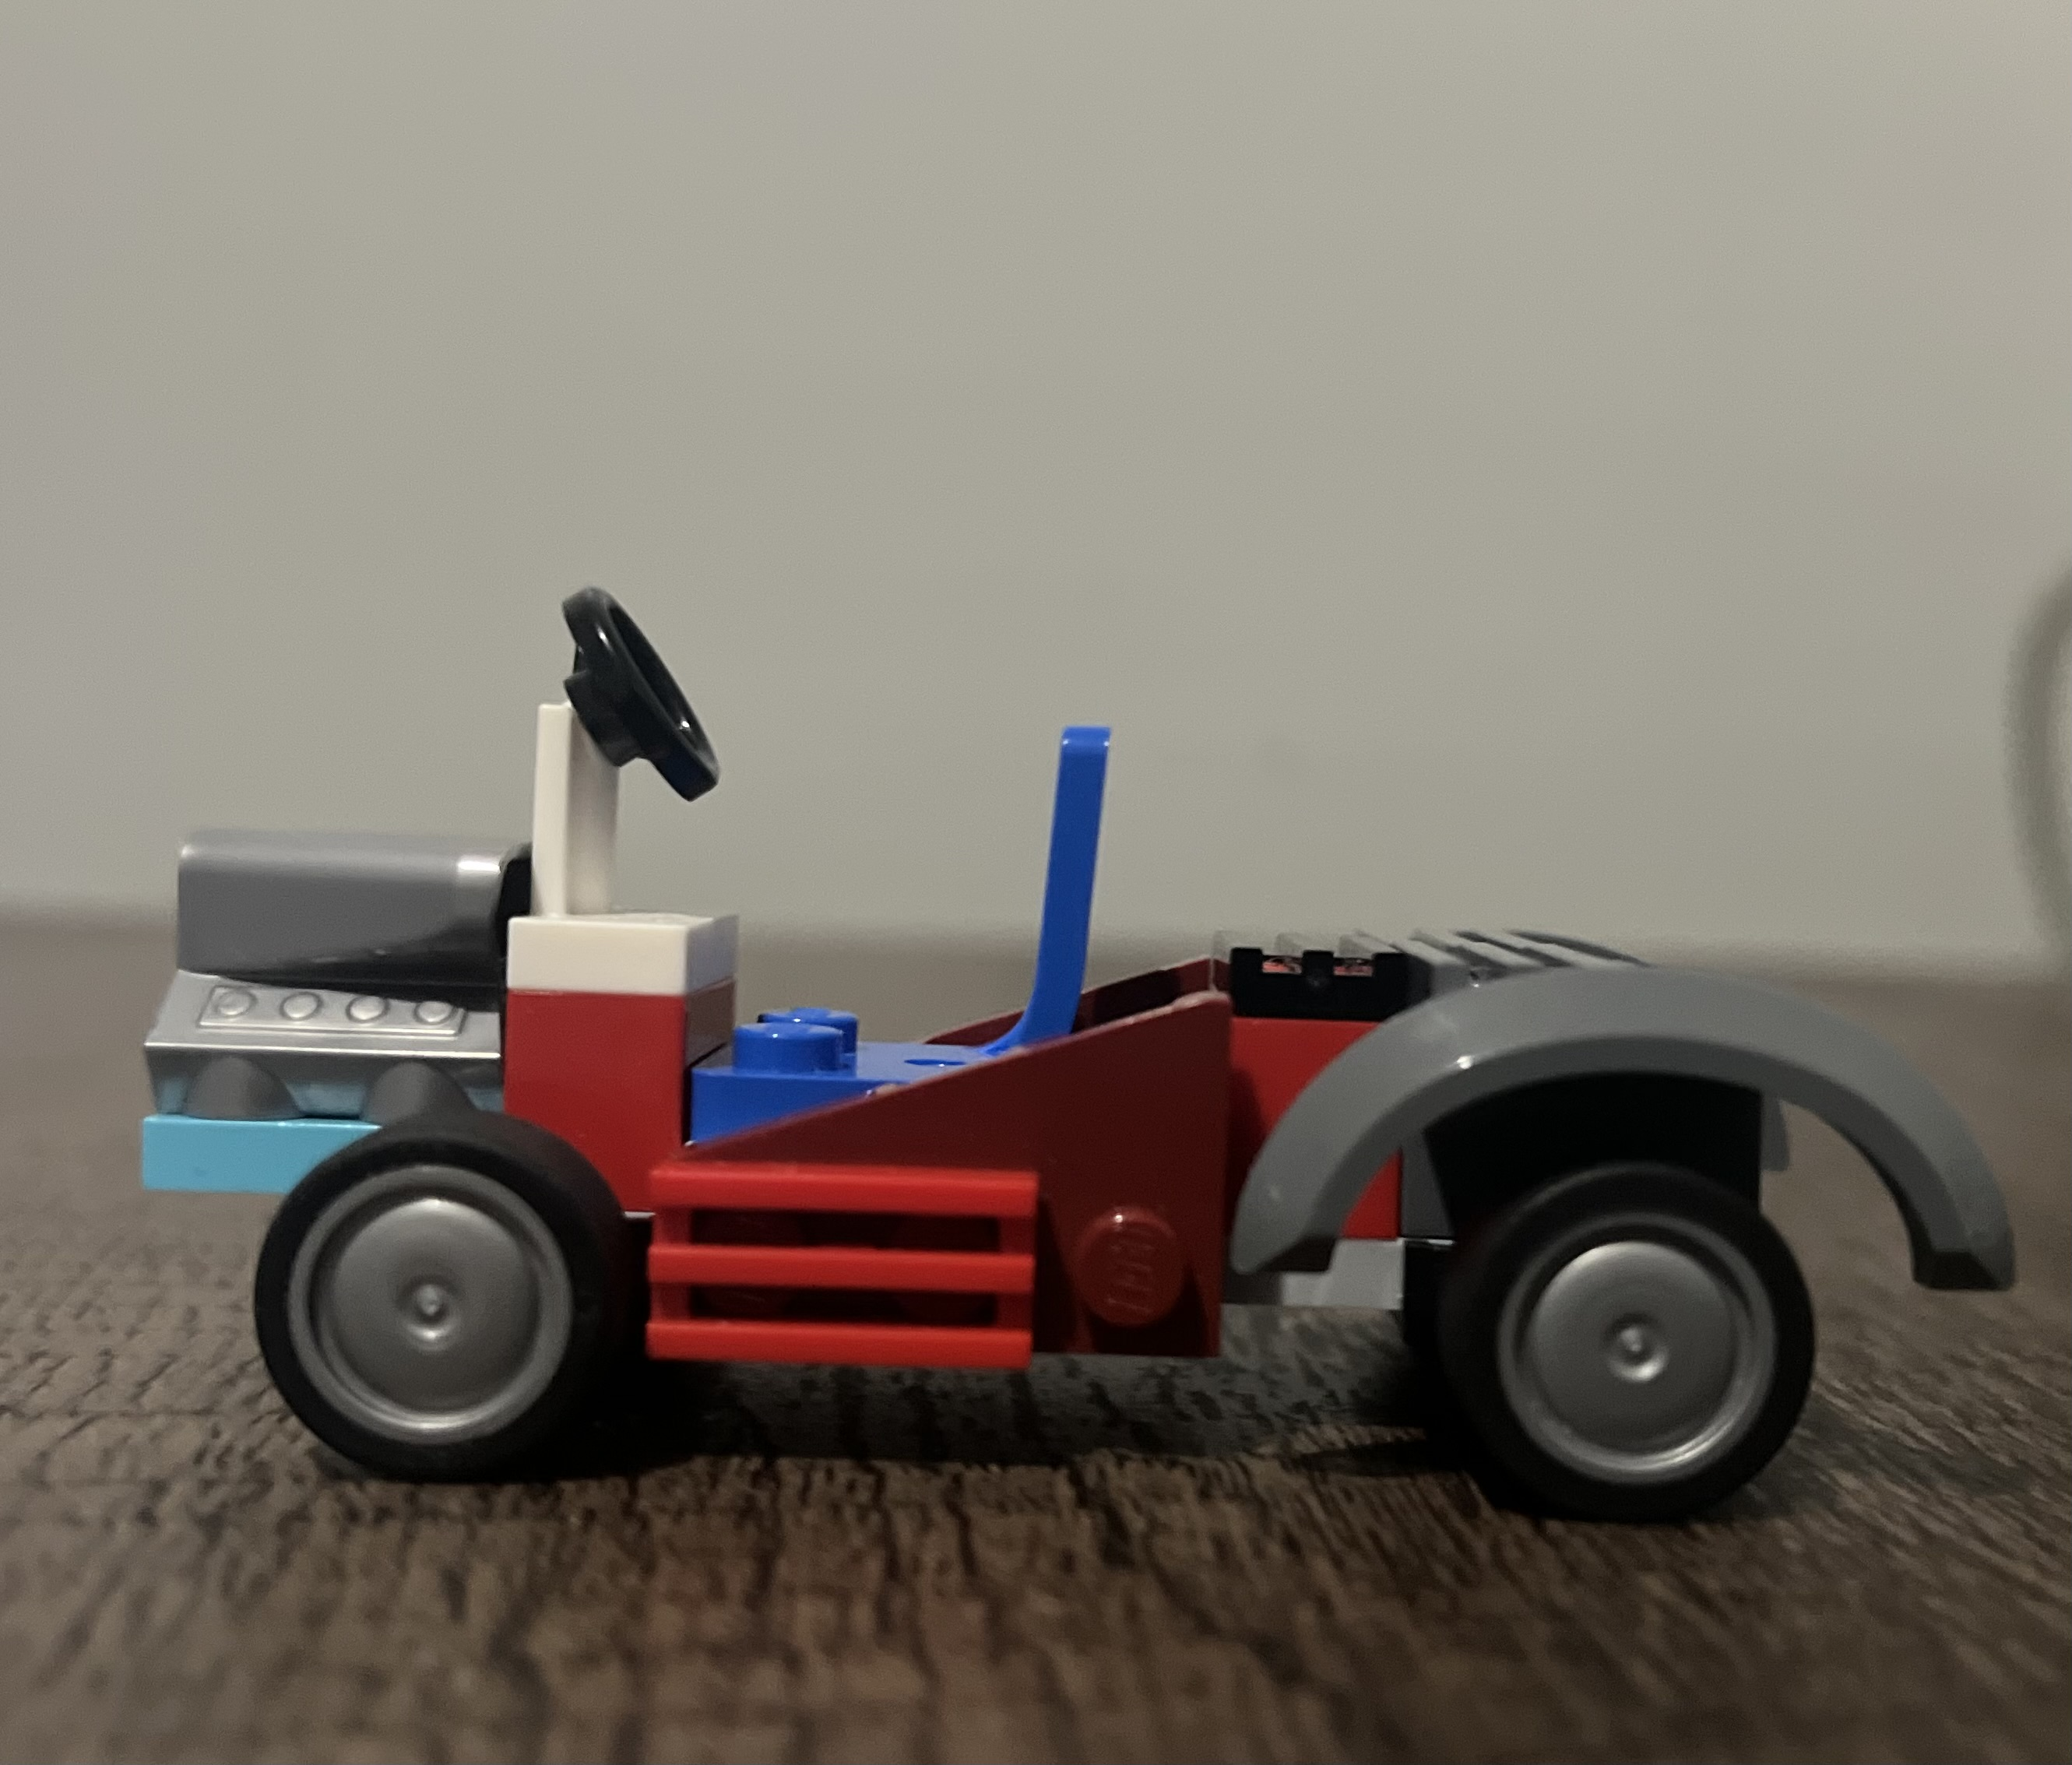
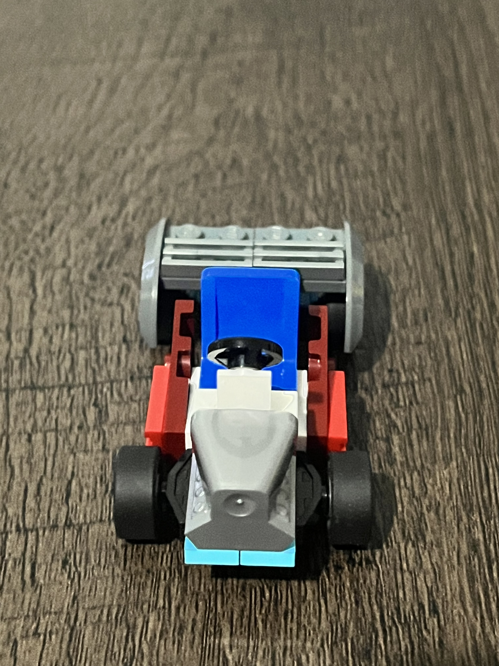
Our Car Design given by model
Side View
Top View

Slide 16
Thank you

